Slide 1
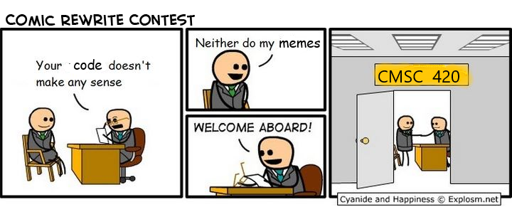
CMSC 420
Advanced Data Structures Section 0101
Mon/Wed, 3:30pm, CSIC1115

Slide 2
Welcome!
CMSC420, “Advanced” Data Structures
Will explain….
Elective, generally junior / senior – level
You need 351 and 330 to register!
Quick facts:
5-6 programming projects in Java, tested on submit.cs.
Lecture worksheets. (start Wednesday)
Homework assignment every 2-3 weeks (5-6 total).
1 midterm, Wed 10-16, 6-8pm, ESJ (Edward St. John's) 0202
1 final, probably Friday Dec 13 from 1:30 - 3:30 based on this.

Slide 3
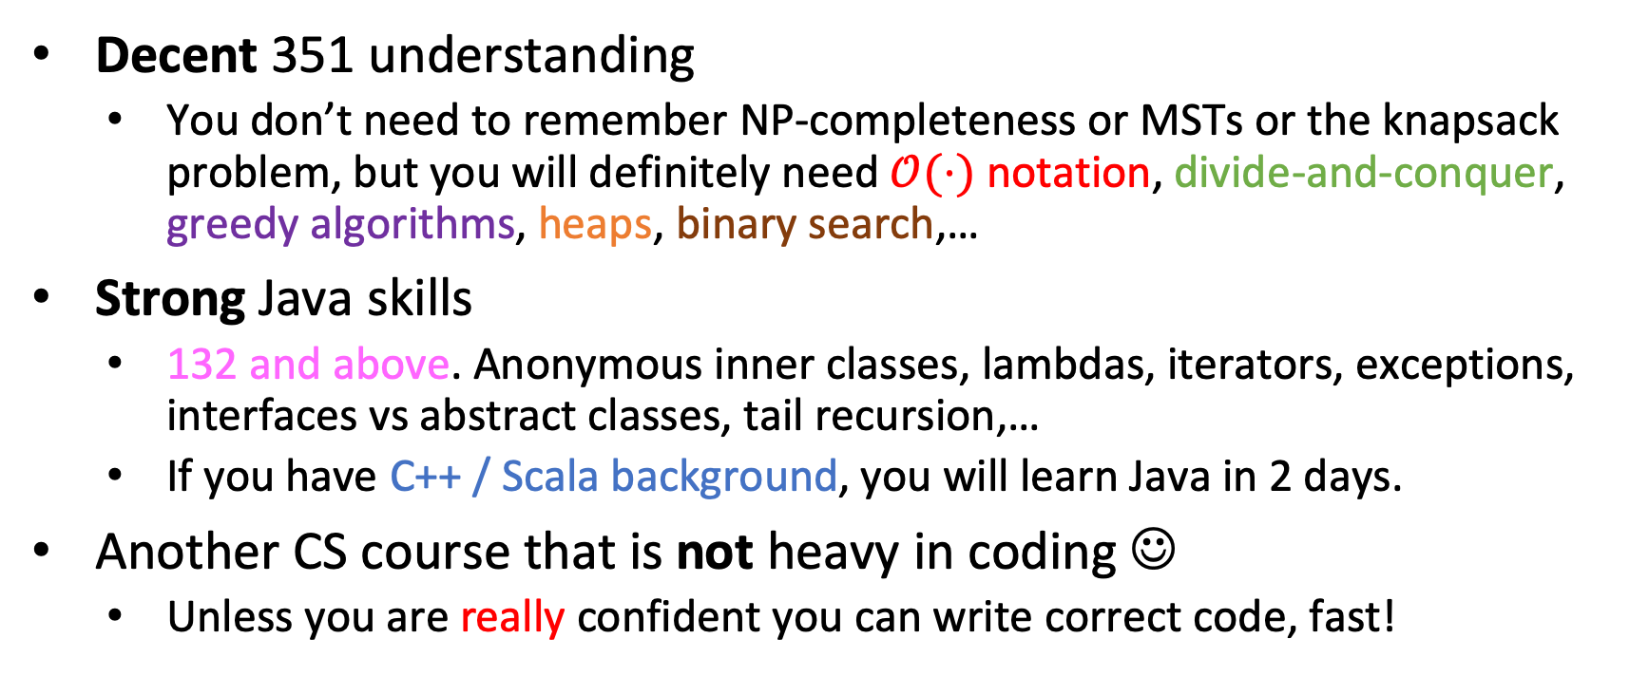
You’ll need
Decent 351 understanding
You don’t need to remember NP-completeness or MSTs or the knapsack problem, but you will definitely need $𝒪(⋅)$ notation, divide-and-conquer, greedy algorithms, heaps, binary search,…
Strong Java skills
132 and above. Anonymous inner classes, lambdas, iterators, exceptions, interfaces vs abstract classes, tail recursion,…
If you have C++ / Scala background, you will learn Java in 2 days.
Another CS course that is not heavy in coding ☺
Unless you are really confident you can write correct code, fast!

Slide 4
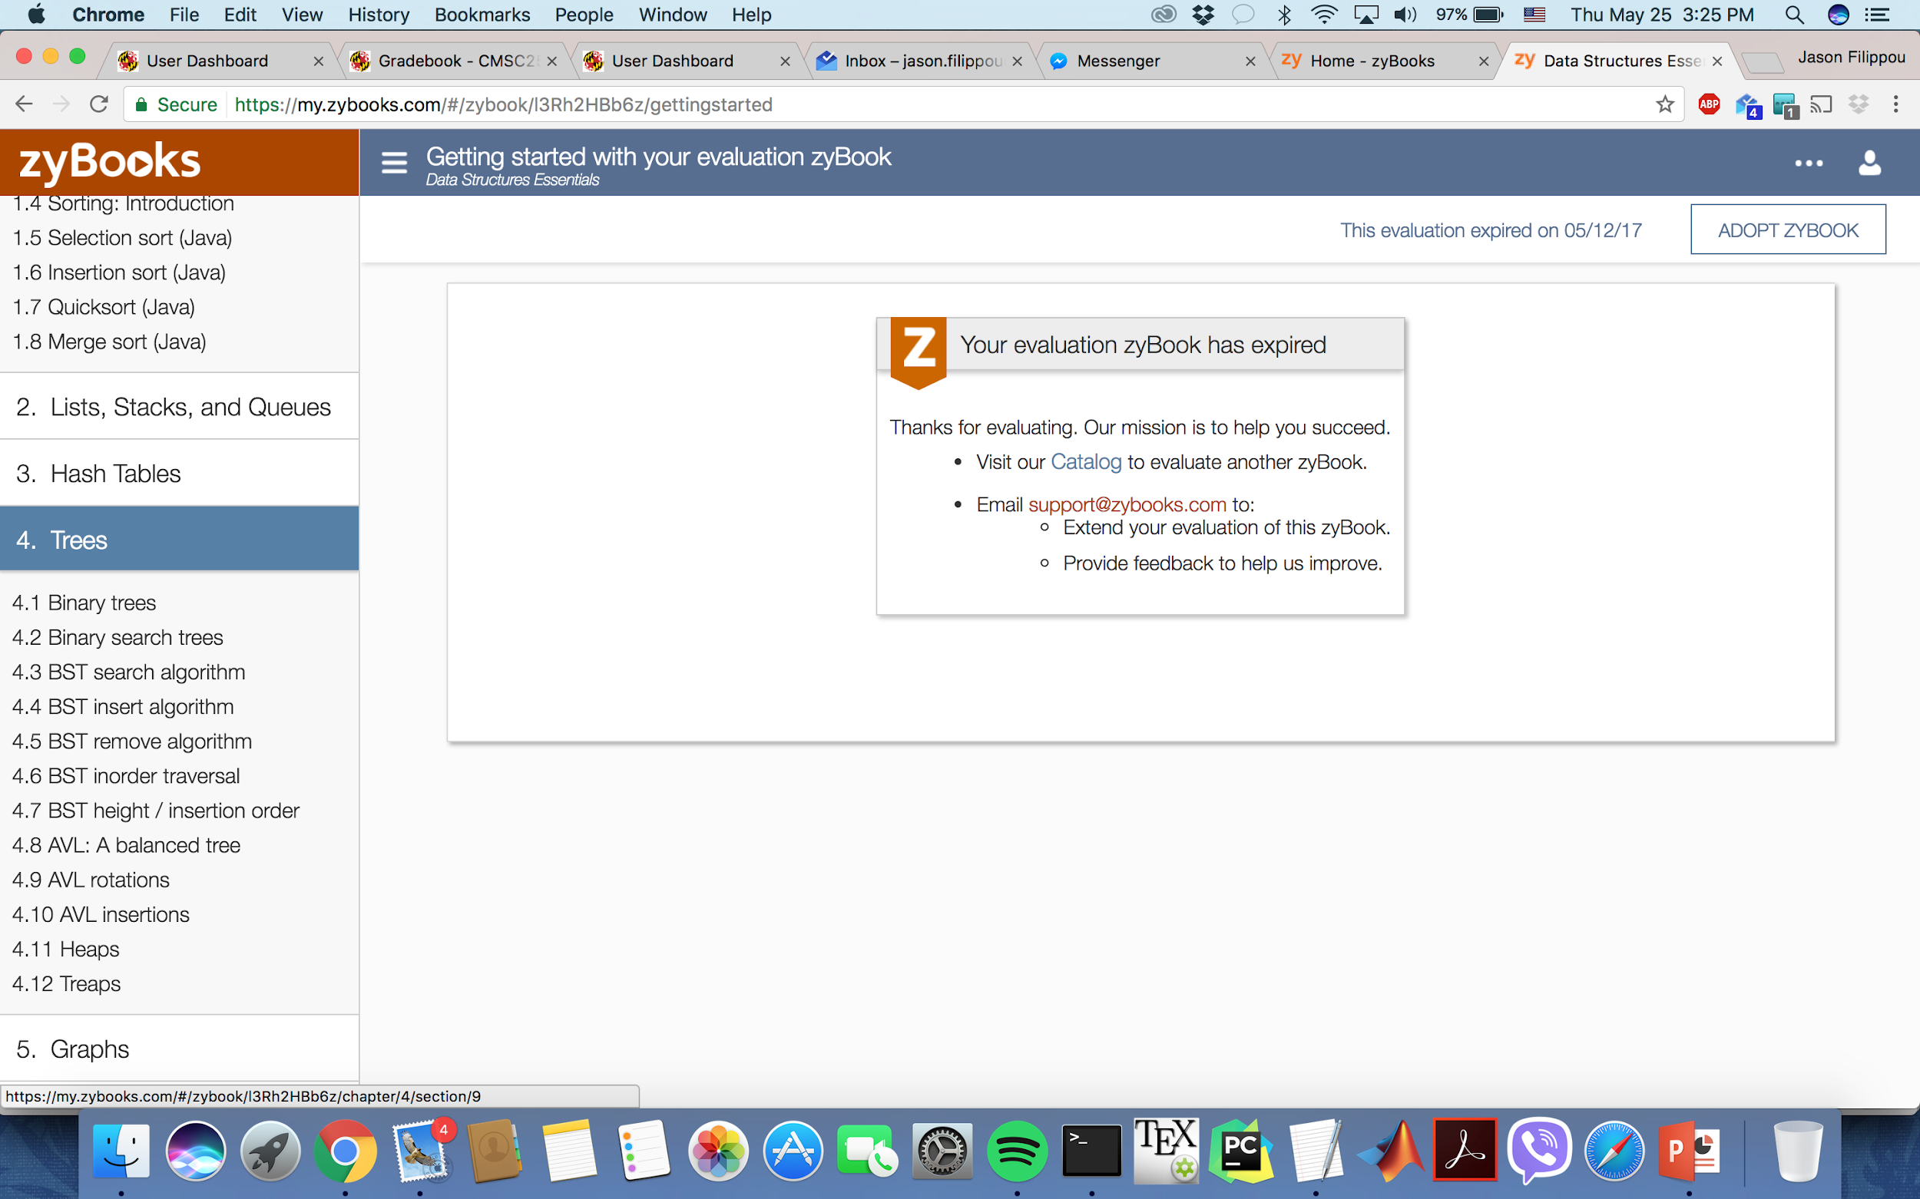
420 in CS UMD

Slide 5

420 in CS UMD

Slide 6
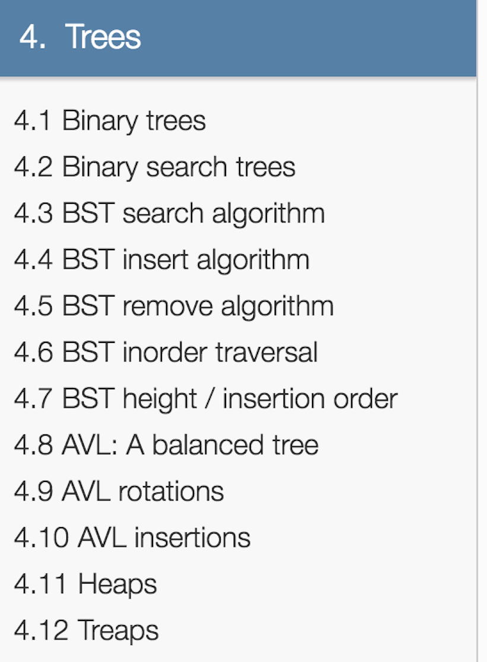
420 in CS UMD

Slide 7

420 in CS UMD
Very basic for 420 (2nd project)

Slide 8
Tower of “core” CS courses
420
451
330
351
132
216
131
250

Slide 9
Tower of “core” CS courses
420
451
330
351
Lists, queues, stacks, BSTs, simple hashes, graphs, heaps.
132
216
131
250

Slide 10

Tower of “core” CS courses
420
451
330
351
Lists, queues, stacks, BSTs, simple hashes, graphs, heaps.
132
216
131
250

Slide 11

Tower of “core” CS courses
Balanced BSTs, B-Trees,
SkipLists, hashing in depth, Tries, Huffman, LZW, KMP, Suffix Trees & Arrays, Huffman, LZW, KD-Trees, QuadTrees, MinHash, LSH….
420
451
330
351
132
216
131
250

Slide 12
Tower of “core” CS courses
Balanced BSTs, B-Trees,
SkipLists, hashing in depth, Tries, Huffman, LZW, KMP, Suffix Trees & Arrays, Huffman, LZW, KD-Trees, QuadTrees, MinHash, LSH….
420
451
330
351
132
216
Hence “Advanced” Data Structures
131
250

Slide 13
A 351 question
Given a double (8 bytes) array A of size N, which among the following sorting algorithms offers the best time complexity?

Slide 14
A 351 question
Given a double (8 bytes) array A of size N, which among the following sorting algorithms offers the best time complexity?
InsertSort
Mergesort
Bubblesort
Selection sort

Slide 15
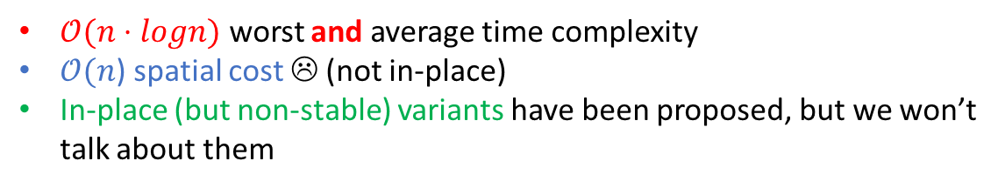
A 351 question …. with a 351 answer!
Given a double (8 bytes) array A of size N, which among the following sorting algorithms offers the best time complexity?
InsertSort
Mergesort
Bubblesort
Selection sort

Slide 16
Another 351 question
Given a linked list of 8 byte integers of size N, does mergesort achieve the same runtime?
Yes
No

Slide 17

Another 351 question… with a 351 answer!
Given a linked list of 8 byte integers of size N, does mergesort achieve the same runtime?
Yes
No
If you do it bottom-up!
For more details with pseudocode, you are directed to the Wikipedia article

Slide 18
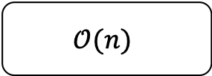
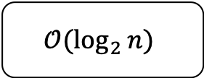
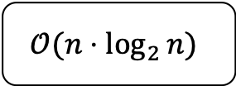
Yet another 351 question
Given a sorted linked list of 8 byte integers of size N, what’s the best runtime we can achieve for binary search?
$$𝒪(\log_{2}{n})$$
$$𝒪(n⋅\log_{2}{n})$$
$$𝒪(n)$$
Something else (what?)

Slide 19

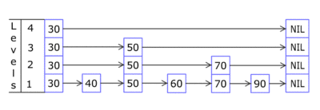
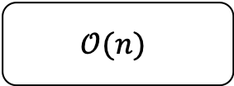
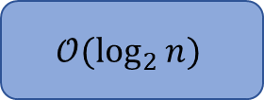
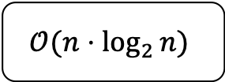
Yet another 351 question.. with a 420 answer!
Given a sorted linked list of 8 byte integers of size N, what’s the best runtime we can achieve for binary search?
$$𝒪(\log_{2}{n})$$
$$𝒪(n⋅\log_{2}{n})$$
$$𝒪(n)$$
Something else (what?)
Use a probabilistic data structure known as a skiplist!
We will talk about it later in the semester.

Slide 20
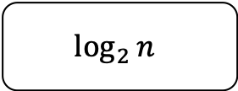
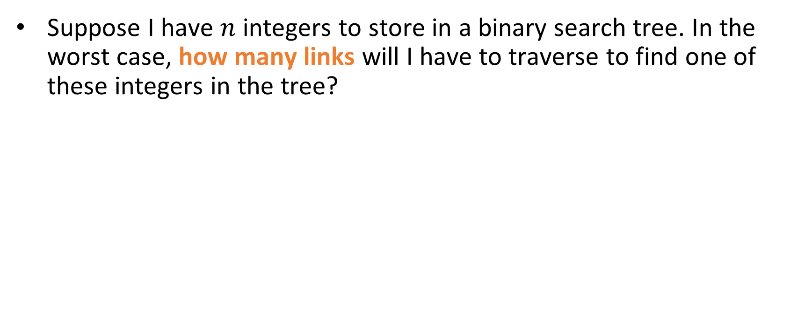
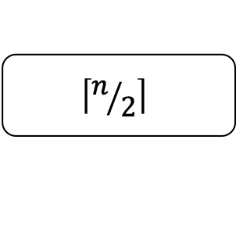


351 question #4
Suppose I have $n$ integers to store in a binary search tree. In the worst case, how many links will I have to traverse to find one of these integers in the tree?
$$\log_{2}{n}$$
$$2n$$
$$n$$
$$\left\lceil n/2\right\rceil$$

Slide 21
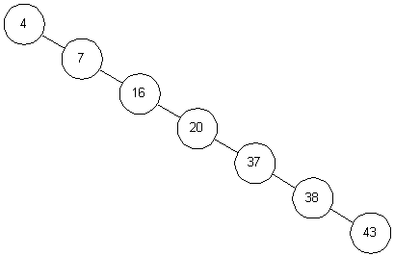

351 question #4
Suppose I have $n$ integers to store in a binary search tree. In the worst case, how many links will I have to traverse to find one of these integers in the tree?
$$\log_{2}{n}$$
$$2n$$
$$n$$
$$\left\lceil n/2\right\rceil$$
Worst case: we receive the input in ascending (or descending) order, and our binary search tree devolves into a linked list ☹

Slide 22

351 question #4
Suppose I have $n$ integers to store in a binary search tree. In the worst case, how many links will I have to traverse to find one of these integers in the tree?
$$\log_{2}{n}$$
$$2n$$
$$n$$
$$\left\lceil n/2\right\rceil$$
Worst case: we receive the input in ascending (or descending) order, and our binary search tree devolves into a linked list ☹
On average, how many links will I traverse to find any one of these keys?

Slide 23

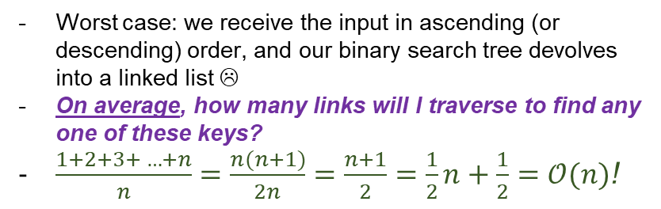
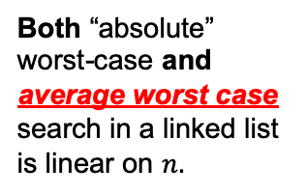
351 question #4
This term will be very important for us, especially in hashing!
Suppose I have $n$ integers to store in a binary search tree. In the worst case, how many links will I have to traverse to find one of these integers in the tree?
Both “absolute” worst-case and average worst case search in a linked list is linear on $n.$
$$\log_{2}{n}$$
$$2n$$
$$n$$
$$\left\lceil n/2\right\rceil$$
Worst case: we receive the input in ascending (or descending) order, and our binary search tree devolves into a linked list ☹
On average, how many links will I traverse to find any one of these keys?
$\frac{1+2+3+ …+n}{n}=\frac{n(n+1)}{2n}=\frac{n+1}{2}=\frac{1}{2}n+\frac{1}{2}=𝒪(n)$!

Slide 24
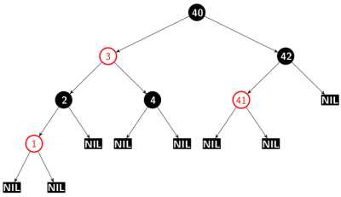
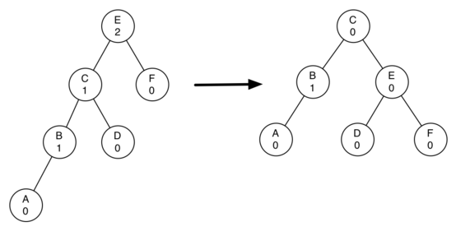
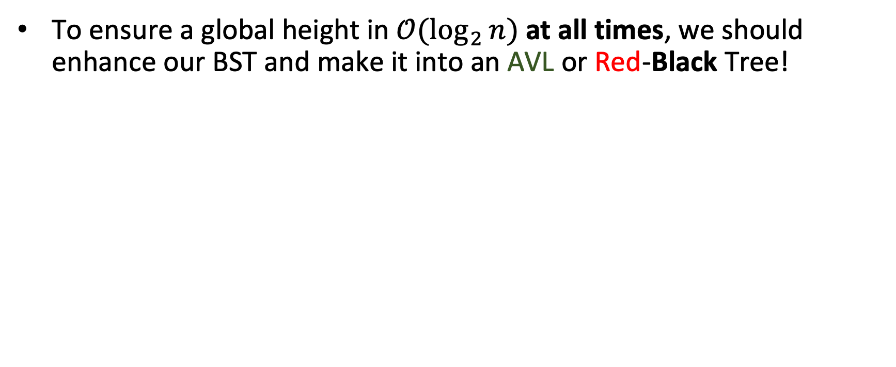
A 420 solution
To ensure a global height in $𝒪(\log_{2}{n)}$ at all times, we should enhance our BST and make it into an AVL or Red-Black Tree!
Example of rotating a node (in this case, the root) in an AVL tree to restore its balance.
A red-black tree

Slide 25
Take-home message #1 : changing structures
Take linked list mergesort scenario.
You moved from an array to a linked list.

Slide 26
Take-home message #1 : changing structures
Take linked list mergesort scenario.
You moved from an array to a linked list.
Why? What’s the chief reason?

Slide 27
Take-home message #1 : changing structures
Take linked list mergesort scenario.
You moved from an array to a linked list.
Why? What’s the chief reason?
Non-contiguous storage in memory.

Slide 28
Take-home message #1 : changing structures
Take linked list mergesort scenario.
You moved from an array to a linked list.
Why? What’s the chief reason?
Non-contiguous storage in memory.
But what if that breaks your existing operations, or makes them less efficient?
You have to make sure this is avoided.
Sometimes (e.g mergesort) this might need a radical change to your algorithm.
Sometimes (e.g binary search in sorted linked list) you might need a new data structure!

Slide 29
Take 2 to chat 420 and each other
How’d you do in 351?
What do you hope to achieve in 420?
Why’d you register for this class?
Olive oil: healthy and delicious or a big Greek conspiracy?
What other courses are you taking?
What have you heard about the projects?
What’s your name?
Any internships?
Where do you come from?
How do you make a Computer Scientist cry?
Favorite programming language?
Any thoughts of grad school?

Slide 30
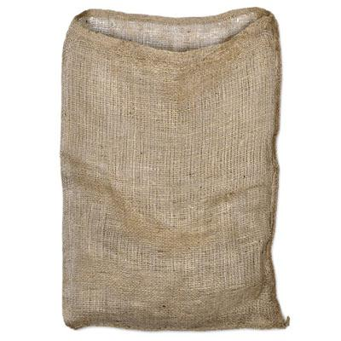
Arrays and Bags…
Perhaps the simplest abstract data structure that we can come up with is a bag
Abstract can mean a lot of things
We think of it as “a conceptual piece of data storage that has to have some properties and time/space constraints for common operations”

Slide 31
Arrays and Bags…
Perhaps the simplest abstract data structure that we can come up with is a bag
Abstract can mean a lot of things
We think of it as “a conceptual piece of data storage that has to have some properties and time/space constraints for common operations”
Requirements:
We want to be able to put stuff in the bag
We want to be able to check if the bag is empty.
We want to check what its size is.
We can “shake” the bag , randomly perturbing the order of its elements (key operation)
We can loop through (iterate over) all of its elements, one at a time.

Slide 32
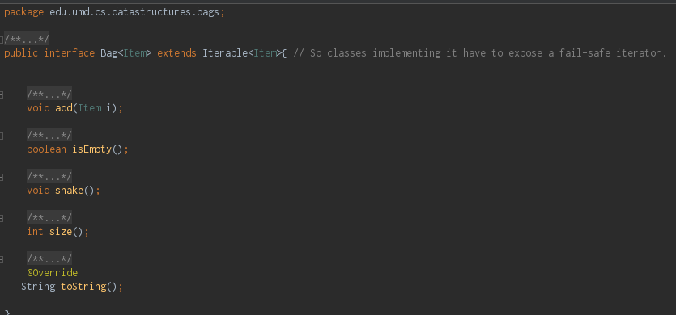
Arrays and Bags…
Requirements:
We want to be able to put stuff in the bag
We want to be able to check if the bag is empty.
We want to check what its size is.
We can “shake” the bag , randomly perturbing the order of its elements (key operation)
We can loop through (iterate over) all of its elements, one at a time.

Slide 33
Arrays and Bags…
Requirements:
We want to be able to put stuff in the bag
We want to be able to check if the bag is empty.
We want to check what its size is.
We can “shake” the bag , randomly perturbing the order of its elements (key operation)
We can loop through (iterate over) all of its elements, one at a time.

Slide 34
Arrays and Bags…
Requirements:
We want to be able to put stuff in the bag
We want to be able to check if the bag is empty.
We want to check what its size is.
We can “shake” the bag , randomly perturbing the order of its elements (key operation)
We can loop through (iterate over) all of its elements, one at a time.
Adding to an interface is fine, as long as you document this addition! ☺

Slide 35

Arrays and Bags…
Let’s switch gears to a Java demo real quick!
Requirements:
We want to be able to put stuff in the bag
We want to be able to check if the bag is empty.
We want to check what its size is.
We can “shake” the bag , randomly perturbing the order of its elements (key operation)
We can loop through (iterate over) all of its elements, one at a time.
Adding to an interface is fine, as long as you document this addition! ☺

Slide 36
Take-home message #2: Hardware Considerations
In this demo we saw a classic difference between CS Theory and (hardware) practice…
Sure, in theory, arrays are constant storage (A[i] requires one to two multiplications and one addition)
But in practice, if they get too large, not all of them can fit in registers, or even cache!
Cache misses make your application (the RandomAccessBag) hurt.
So even for the simplest possible data structure a language gives us (1D array), theory and practice diverge!

Slide 37



Not allowed in lecture!
If you make a mistake on a worksheet, cross it out with your pen or pencil so that:
(a) We can grade you fairly and
(b) You can see your mistake when you study again and remember why you made it (the worksheets will assist you with this)

Slide 38

Worksheets
Some of our slides will have this icon:
It means that the question should be answered in your worksheets.
If you get a question wrong, write the right answer under the line we provide. Also include the reasons for which you got it wrong!
Do not erase or cross out the answer! Write down the right answer under the line!

Slide 39
Another example: Java Arraylists
Let’s look at the ArrayList’s docs for a moment…

Slide 40
Another example: Java Arraylists
Let’s look at the ArrayList’s docs for a moment…
What’s with this “amortized constant time” required for additions? Since the underlying implementation is an array, we’d expect just constant!

Slide 41
Another example: Java Arraylists
Let’s look at the ArrayList’s docs for a moment…
What’s with this “amortized constant time” required for additions? Since the underlying implementation is an array, we’d expect just constant!
Note the docs for the constructors… default starting capacity at 10. When inserting 11th element, we need linear time to copy over to new internal array. ☹
But! For the next 9 elements, we have constant time! ☺

Slide 42
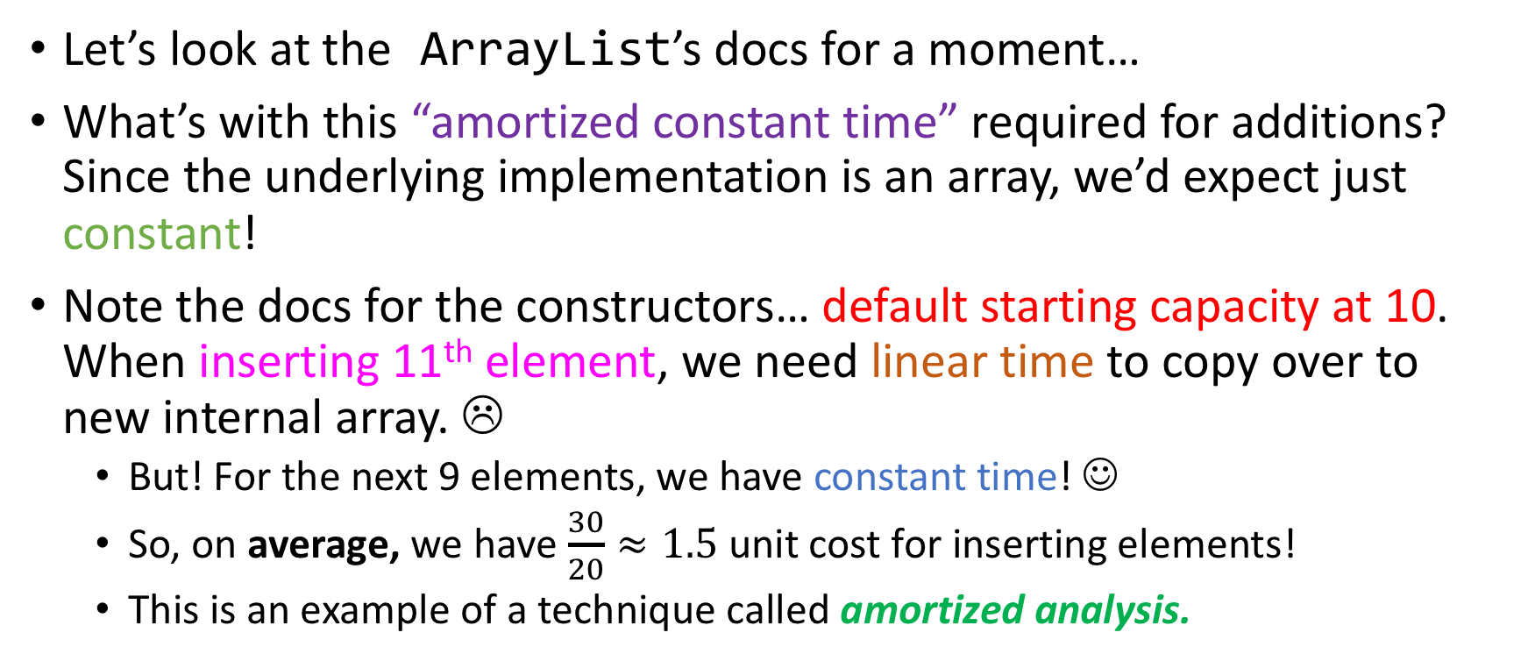
Another example: Java Arraylists

Slide 43
Practice
Suppose that we have an ArrayList list1 which begins with 10 cells and adds 10 empty cells every time it gets full.
Concretely, it will resize itself at the first insertion that happens while it is already full.
So, the first resizing will happen at the eleventh insertion.

Slide 44
Practice
Suppose that we have an ArrayList list1 which begins with 10 cells and adds 10 empty cells every time it gets full.
Concretely, it will resize itself at the first insertion that happens while it is already full.
So, the first resizing will happen at the eleventh insertion.
What is the amortized cost of inserting 50 elements into list1?

Slide 45
Practice
Suppose that we have an ArrayList list1 which begins with 10 cells and adds 10 empty cells every time it gets full.
Concretely, it will resize itself at the first insertion that happens while it is already full.
So, the first resizing will happen at the eleventh insertion.
What is the amortized cost of inserting 50 elements into list1?
Worksheet time!

Slide 46
Practice
Suppose now that we have an ArrayList list2 which begins with 10 cells and doubles its size every time it gets full!
What is the amortized cost of inserting 50 elements into list2?

Slide 47
Take-home message #3: Amortized Complexity
If most of the time our operation runs very fast, are we willing to accept bad performance once in a while?
Amortized analysis can answer this question.
ArrayLists, Splay Trees and Self-organizing hash tables are all data structures where certain operations have amortized constant complexity!

Slide 48
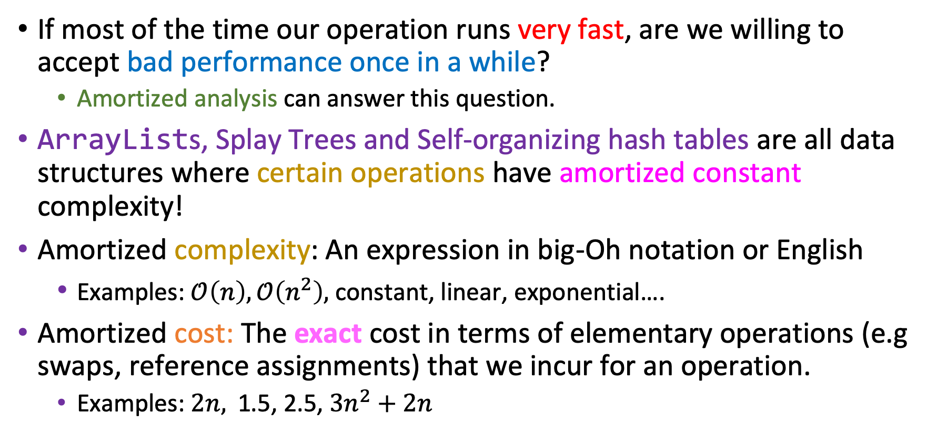
Take-home message #3: Amortized Complexity
If most of the time our operation runs very fast, are we willing to accept bad performance once in a while?
Amortized analysis can answer this question.
ArrayLists, Splay Trees and Self-organizing hash tables are all data structures where certain operations have amortized constant complexity!
Amortized complexity: An expression in big-Oh notation or English
Examples: $𝒪\left(n\right),𝒪\left(n^{2}\right),$ constant, linear, exponential….
Amortized cost: The exact cost in terms of elementary operations (e.g swaps, reference assignments) that we incur for an operation.
Examples: $2n,$ 1.5, 2.5, $3n^{2}+2n$

Slide 49
Reminder: Binary tree traversals
root
L
R

Slide 50
Reminder: Binary tree traversals
Preorder traversal is…
(a) L r R
(b) r L R
(c) r R L
(d) L R r
root
L
R

Slide 51
Reminder: Binary tree traversals
Preorder traversal is…
(a) L r R
(b) r L R
(c) r R L
(d) L R r
(1)
Mnemonic rule (maybe?): pre-order traversal, as in pre-visit the root before the subtrees
root
(2)
L
R
(3)

Slide 52
Reminder: Binary tree traversals
Inorder traversal is…
(a) L r R
(b) r L R
(c) r R L
(d) L R r
root
L
R

Slide 53
Reminder: Binary tree traversals
Inorder traversal is…
(a) L r R
(b) r L R
(c) r R L
(d) L R r
(2)
Mnemonic rule (maybe?): in-order traversal, as in “visit the root in-between the subtrees”
root
(1)
L
R
(3)

Slide 54
Reminder: Binary tree traversals
Postorder traversal is…
(a) L r R
(b) r L R
(c) r R L
(d) L R r
root
L
R

Slide 55
Reminder: Binary tree traversals
Postorder traversal is…
(a) L r R
(b) r L R
(c) r R L
(d) L R r
(3)
Mnemonic rule (maybe?): post-order traversal, as in “visit the root post-visiting the subtrees”
root
(1)
L
R
(2)

Slide 56
Question for you
R
< R
>=R
Suppose that our binary tree is a binary search tree

Slide 57
Question for you
R
< R
>=R
Suppose that our binary tree is a binary search tree
Which tree traversal is the most useful one for BSTs, and why?
Preorder
Inorder
Postorder

Slide 58
Question for you
R
< R
>=R
Suppose that our binary tree is a binary search tree
Which tree traversal is the most useful one for BSTs, and why?
Preorder
Inorder
Postorder
In BSTs, Inorder is Sorted order! :)

Slide 59
Here’s a BST
M
A
X
x
E
x
x
x
F
x
G
x
x

Slide 60
Here’s a BST
M
Tell me THREE things you don’t like about this tree.
A
X
x
E
x
x
x
F
x
G
x
x

Slide 61
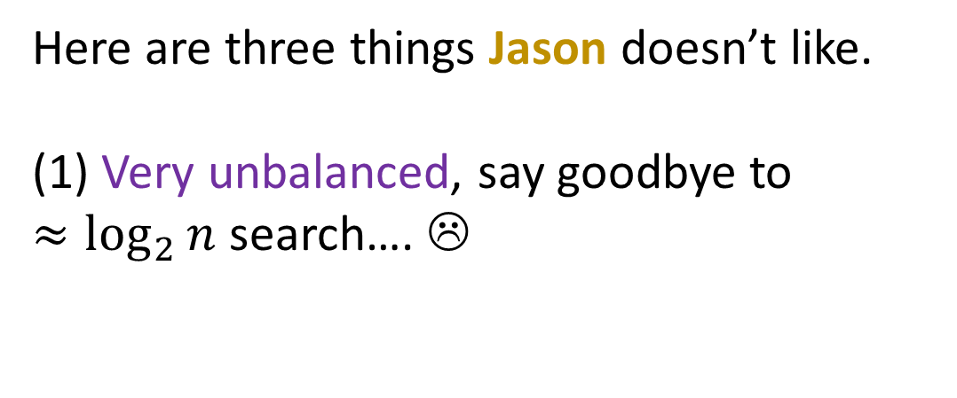
Here’s a BST
M
A
X
x
E
x
x
x
F
x
G
x
x

Slide 62
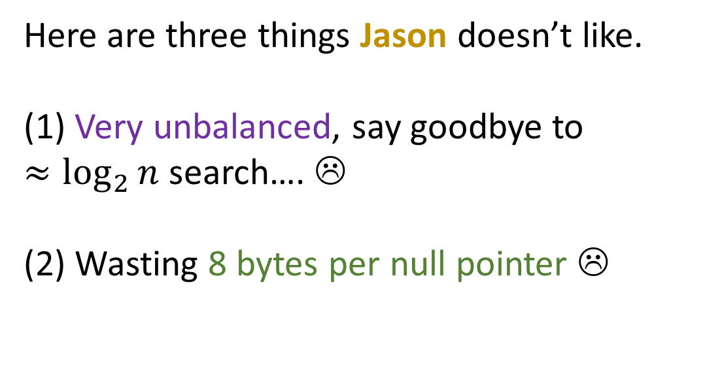
Here’s a BST
M
A
X
x
E
x
x
x
F
x
G
x
x

Slide 63
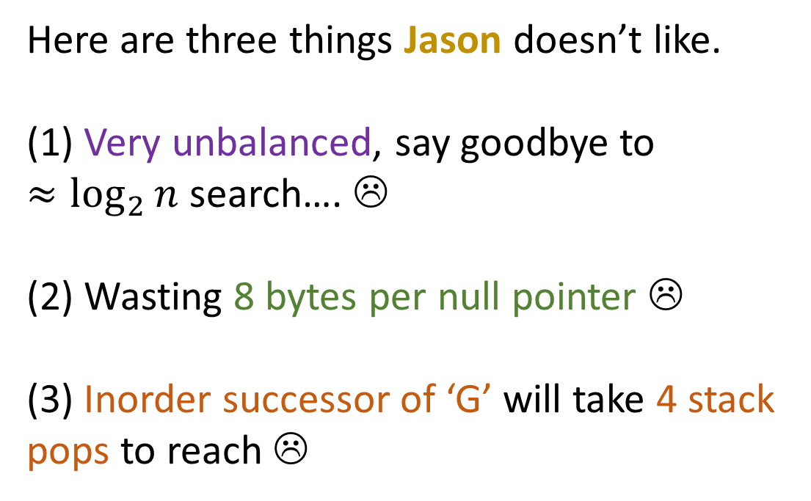
Here’s a BST
M
A
X
x
E
x
x
x
F
x
G
x
x

Slide 64
Here’s a BST
M
A
X
x
E
x
x
x
F
x
G
x
x

Slide 65
Here’s a BST
M
A
X
x
E
x
x
x
F
x
G
x
x

Slide 66
Here’s a BST
M
A
X
x
E
x
x
x
F
x
G
x
x

Slide 67
Here’s a BST
M
A
X
x
E
x
x
x
F
x
G
x
x

Slide 68

Here’s a BST
M
A
X
AVL / Splay / Red-Black Trees
x
E
x
x
x
F
x
G
x
x
Threaded binary search trees

Slide 69
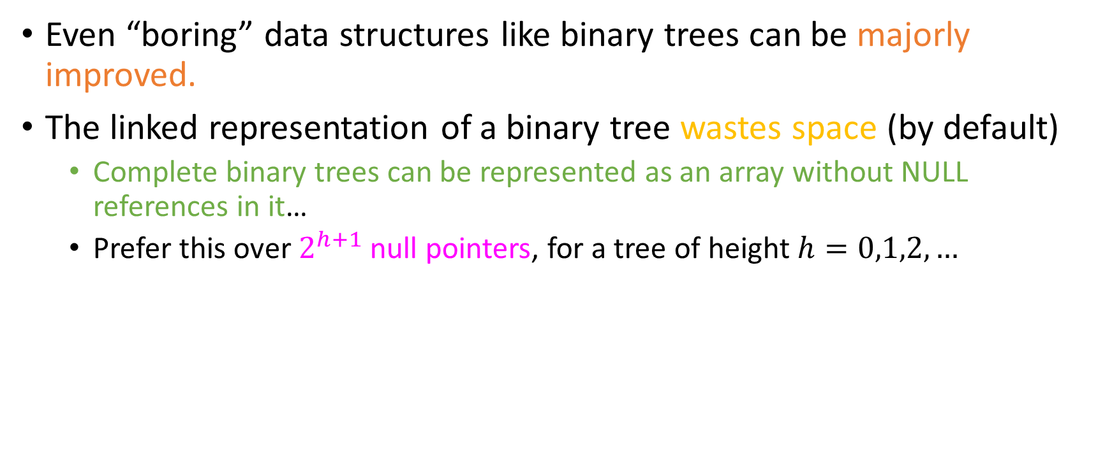
Take-home message #4: improvements of basic structures

Slide 70
We talked storage; what about operations?
Which among the following Java sum calculations will run faster?
(a)
(b)
(c)
long sum = 0;
for(int i = 0; i < 1000; i++)
for(int j = 0; j < 1000; j++)
sum += A[i][j];
long sum = 0;
for(int i = 0; i < 1000; i++)
for(int j = 0; j < 1000; j++)
sum += A[j][i];
They will both need about the same amount of CPU cycles to run.

Slide 71
We talked storage; what about operations?
Which among the following Java sum calculations will run faster?
(a)
(b)
(c)
long sum = 0;
for(int i = 0; i < 1000; i++)
for(int j = 0; j < 1000; j++)
sum += A[i][j];
long sum = 0;
for(int i = 0; i < 1000; i++)
for(int j = 0; j < 1000; j++)
sum += A[j][i];
They will both need about the same amount of CPU cycles to run.
This “classic” loop leverages row-major order!

Slide 72
We talked storage; what about operations?
Which among the following Java sum calculations will run faster?
(a)
(b)
(c)
long sum = 0;
for(int i = 0; i < 1000; i++)
for(int j = 0; j < 1000; j++)
sum += A[i][j];
long sum = 0;
for(int i = 0; i < 1000; i++)
for(int j = 0; j < 1000; j++)
sum += A[j][i];
They will both need about the same amount of CPU cycles to run.
This “classic” loop leverages row-major order!
Time for another Java demo!

Slide 73
Any languages that do column-major order?
Yes (which?)
No (why?)

Slide 74
Any languages that do column-major order?
Yes (which?)
No (why?)
MATLAB, GNU Octave, LISP…
Semantics of M[i][j] the same
Only storage different, with whatever that implies about operations…

Slide 75

Any languages that do column-major order?
Yes (which?)
No (why?)
MATLAB, GNU Octave, LISP…
Semantics of M[i][j] the same
Only storage different, with whatever that implies about operations…
Time for a MATLAB demo!

Slide 76
How row-major works…
Here’s a matrix M of 8 byte doubles:
M
2.33 | 8.145 | 67.9823 | 17.02 | 8.1 | 96.480 | -25.05
5.67012 | 4.2 | -100.02 | -5600.1 | 32 | 25.789 | 89.01
521.23 | -0.16 | 45.89 | 49 | 3.21 | -1 | -34.2
0.01 | -32 | 34.578 | -0.07 | 2.899 | 390245 | 87.1
567.98 | 89.56923 | -897.6 | 90 | 0.45923 | -67.45 | 25.6
-40.23 | 17.32 | 0 | -6.43 | 100.56 | 0.01 | 5.23
702.97 | 14.56 | 56.79 | 100 | 12.6 | -0.0001 | -4.1

Slide 77
How row-major works…
double **M
. . .
double M[0][1]
double M[0][2]
double M[0][6]
double* M[0]
 | 2.33 | 8.145 | 67.9823 | 17.02 | 8.1 | 96.480 | -25.05
 | 5.6701 | 4.2 | -100.02 | -5600.1 | 32 | 25.789 | 89.01
 | 521.23 | -0.16 | 45.89 | 49 | 3.21 | -1 | -34.2
 | 0.01 | -32 | 34.578 | -0.07 | 2.899 | 390245 | 87.1
 | 567.98 | 89.56923 | -897.6 | 90 | 0.45923 | -67.45 | 25.6
 | -40.23 | 17.32 | 0 | -6.43 | 100.56 | 0.01 | 5.23
double* M[6] | 702.97 | 14.56 | 56.79 | 100 | 12.6 | -0.0001 | -4.1
double* M[1]

Slide 78
How row-major works…
double **M
. . .
. . .
double M[0][1]
double M[0][2]
double M[0][6]
double* M[0]
 | 2.33 | 8.145 | 67.9823 | 17.02 | 8.1 | 96.480 | -25.05
 | 5.6701 | 4.2 | -100.02 | -5600.1 | 32 | 25.789 | 89.01
 | 521.23 | -0.16 | 45.89 | 49 | 3.21 | -1 | -34.2
 | 0.01 | -32 | 34.578 | -0.07 | 2.899 | 390245 | 87.1
 | 567.98 | 89.56923 | -897.6 | 90 | 0.45923 | -67.45 | 25.6
 | -40.23 | 17.32 | 0 | -6.43 | 100.56 | 0.01 | 5.23
double* M[6] | 702.97 | 14.56 | 56.79 | 100 | 12.6 | -0.0001 | -4.1
double* M[1]
double M[6][1]
double M[6][2]
double M[6][6]
So you need another column for pointers, and another cell for the initial pointer.

Slide 79
How row-major works…
double **M
. . .
. . .
double M[0][1]
double M[0][2]
double M[0][6]
double* M[0]
 | 2.33 | 8.145 | 67.9823 | 17.02 | 8.1 | 96.480 | -25.05
 | 5.6701 | 4.2 | -100.02 | -5600.1 | 32 | 25.789 | 89.01
 | 521.23 | -0.16 | 45.89 | 49 | 3.21 | -1 | -34.2
 | 0.01 | -32 | 34.578 | -0.07 | 2.899 | 390245 | 87.1
 | 567.98 | 89.56923 | -897.6 | 90 | 0.45923 | -67.45 | 25.6
 | -40.23 | 17.32 | 0 | -6.43 | 100.56 | 0.01 | 5.23
double* M[6] | 702.97 | 14.56 | 56.79 | 100 | 12.6 | -0.0001 | -4.1
double* M[1]
double M[6][1]
double M[6][2]
double M[6][6]
So you need another column for pointers, and another cell for the initial pointer.
Assumed array size: 49 * 8 = 392 bytes . Real size: 49* 8 for data + 7*8 for row references + 1*8 for initial reference = 456 bytes!

Slide 80
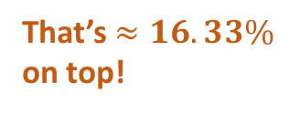
How row-major works…
double **M
. . .
. . .
double M[0][1]
double M[0][2]
double M[0][6]
double* M[0]
 | 2.33 | 8.145 | 67.9823 | 17.02 | 8.1 | 96.480 | -25.05
 | 5.6701 | 4.2 | -100.02 | -5600.1 | 32 | 25.789 | 89.01
 | 521.23 | -0.16 | 45.89 | 49 | 3.21 | -1 | -34.2
 | 0.01 | -32 | 34.578 | -0.07 | 2.899 | 390245 | 87.1
 | 567.98 | 89.56923 | -897.6 | 90 | 0.45923 | -67.45 | 25.6
 | -40.23 | 17.32 | 0 | -6.43 | 100.56 | 0.01 | 5.23
double* M[6] | 702.97 | 14.56 | 56.79 | 100 | 12.6 | -0.0001 | -4.1
double* M[1]
double M[6][1]
double M[6][2]
double M[6][6]
So you need another column for pointers, and another cell for the initial pointer.
Assumed array size: 49 * 8 = 392 bytes . Real size: 49* 8 for data + 7*8 for row references + 1*8 for initial reference = 456 bytes!

Slide 81
The bigger problem…
double **M
 | 2.33 | 8.145 | 67.9823 | 17.02 | 8.1 | 96.480 | -25.05
 | 5.6701 | 4.2 | -100.02 | -5600.1 | 32 | 25.789 | 89.01
 | 521.23 | -0.16 | 45.89 | 49 | 3.21 | -1 | -34.2
 | 0.01 | -32 | 34.578 | -0.07 | 2.899 | 390245 | 87.1
 | 567.98 | 89.56923 | -897.6 | 90 | 0.45923 | -67.45 | 25.6
 | -40.23 | 17.32 | 0 | -6.43 | 100.56 | 0.01 | 5.23
double* M[6] | 702.97 | 14.56 | 56.79 | 100 | 12.6 | -0.0001 | -4.1
double* M[0]
double* M[1]

Slide 82
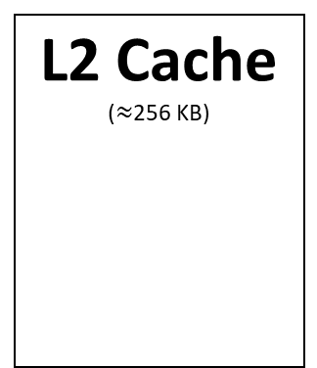
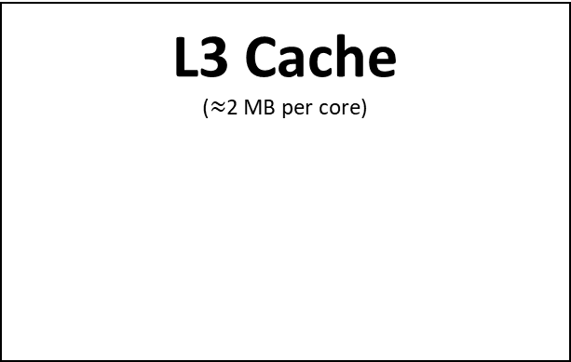
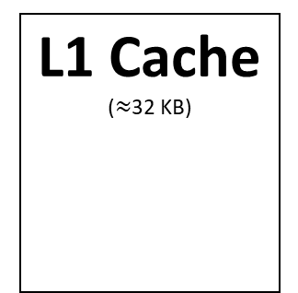
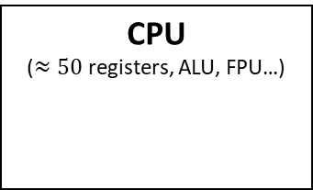
The bigger problem…
double **M
 | 2.33 | 8.145 | 67.9823 | 17.02 | 8.1 | 96.480 | -25.05
 | 5.6701 | 4.2 | -100.02 | -5600.1 | 32 | 25.789 | 89.01
 | 521.23 | -0.16 | 45.89 | 49 | 3.21 | -1 | -34.2
 | 0.01 | -32 | 34.578 | -0.07 | 2.899 | 390245 | 87.1
 | 567.98 | 89.56923 | -897.6 | 90 | 0.45923 | -67.45 | 25.6
 | -40.23 | 17.32 | 0 | -6.43 | 100.56 | 0.01 | 5.23
double* M[6] | 702.97 | 14.56 | 56.79 | 100 | 12.6 | -0.0001 | -4.1
double* M[0]
double* M[1]

Slide 83
The bigger problem…
double **M
 | 2.33 | 8.145 | 67.9823 | 17.02 | 8.1 | 96.480 | -25.05
 | 5.6701 | 4.2 | -100.02 | -5600.1 | 32 | 25.789 | 89.01
 | 521.23 | -0.16 | 45.89 | 49 | 3.21 | -1 | -34.2
 | 0.01 | -32 | 34.578 | -0.07 | 2.899 | 390245 | 87.1
 | 567.98 | 89.56923 | -897.6 | 90 | 0.45923 | -67.45 | 25.6
 | -40.23 | 17.32 | 0 | -6.43 | 100.56 | 0.01 | 5.23
double* M[6] | 702.97 | 14.56 | 56.79 | 100 | 12.6 | -0.0001 | -4.1
double* M[0]
double* M[1]

Slide 84
The bigger problem…
double **M
 | 2.33 | 8.145 | 67.9823 | 17.02 | 8.1 | 96.480 | -25.05
 | 5.6701 | 4.2 | -100.02 | -5600.1 | 32 | 25.789 | 89.01
 | 521.23 | -0.16 | 45.89 | 49 | 3.21 | -1 | -34.2
 | 0.01 | -32 | 34.578 | -0.07 | 2.899 | 390245 | 87.1
 | 567.98 | 89.56923 | -897.6 | 90 | 0.45923 | -67.45 | 25.6
 | -40.23 | 17.32 | 0 | -6.43 | 100.56 | 0.01 | 5.23
double* M[6] | 702.97 | 14.56 | 56.79 | 100 | 12.6 | -0.0001 | -4.1
double* M[0]
double* M[1]

Slide 85
The bigger problem…
double **M
 | 2.33 | 8.145 | 67.9823 | 17.02 | 8.1 | 96.480 | -25.05
 | 5.6701 | 4.2 | -100.02 | -5600.1 | 32 | 25.789 | 89.01
 | 521.23 | -0.16 | 45.89 | 49 | 3.21 | -1 | -34.2
 | 0.01 | -32 | 34.578 | -0.07 | 2.899 | 390245 | 87.1
 | 567.98 | 89.56923 | -897.6 | 90 | 0.45923 | -67.45 | 25.6
 | -40.23 | 17.32 | 0 | -6.43 | 100.56 | 0.01 | 5.23
double* M[6] | 702.97 | 14.56 | 56.79 | 100 | 12.6 | -0.0001 | -4.1
double* M[0]
double* M[1]

Slide 86
The bigger problem…
double **M
 | 2.33 | 8.145 | 67.9823 | 17.02 | 8.1 | 96.480 | -25.05
 | 5.6701 | 4.2 | -100.02 | -5600.1 | 32 | 25.789 | 89.01
 | 521.23 | -0.16 | 45.89 | 49 | 3.21 | -1 | -34.2
 | 0.01 | -32 | 34.578 | -0.07 | 2.899 | 390245 | 87.1
 | 567.98 | 89.56923 | -897.6 | 90 | 0.45923 | -67.45 | 25.6
 | -40.23 | 17.32 | 0 | -6.43 | 100.56 | 0.01 | 5.23
double* M[6] | 702.97 | 14.56 | 56.79 | 100 | 12.6 | -0.0001 | -4.1
double* M[0]
double* M[1]

Slide 87
The bigger problem…
double **M
 | 2.33 | 8.145 | 67.9823 | 17.02 | 8.1 | 96.480 | -25.05
 | 5.6701 | 4.2 | -100.02 | -5600.1 | 32 | 25.789 | 89.01
 | 521.23 | -0.16 | 45.89 | 49 | 3.21 | -1 | -34.2
 | 0.01 | -32 | 34.578 | -0.07 | 2.899 | 390245 | 87.1
 | 567.98 | 89.56923 | -897.6 | 90 | 0.45923 | -67.45 | 25.6
 | -40.23 | 17.32 | 0 | -6.43 | 100.56 | 0.01 | 5.23
double* M[6] | 702.97 | 14.56 | 56.79 | 100 | 12.6 | -0.0001 | -4.1
double* M[0]
double* M[1]

Slide 88
The bigger problem…
double **M
 | 2.33 | 8.145 | 67.9823 | 17.02 | 8.1 | 96.480 | -25.05
 | 5.6701 | 4.2 | -100.02 | -5600.1 | 32 | 25.789 | 89.01
 | 521.23 | -0.16 | 45.89 | 49 | 3.21 | -1 | -34.2
 | 0.01 | -32 | 34.578 | -0.07 | 2.899 | 390245 | 87.1
 | 567.98 | 89.56923 | -897.6 | 90 | 0.45923 | -67.45 | 25.6
 | -40.23 | 17.32 | 0 | -6.43 | 100.56 | 0.01 | 5.23
double* M[6] | 702.97 | 14.56 | 56.79 | 100 | 12.6 | -0.0001 | -4.1
double* M[0]
double* M[1]

Slide 89
The bigger problem…
double **M
 | 2.33 | 8.145 | 67.9823 | 17.02 | 8.1 | 96.480 | -25.05
 | 5.6701 | 4.2 | -100.02 | -5600.1 | 32 | 25.789 | 89.01
 | 521.23 | -0.16 | 45.89 | 49 | 3.21 | -1 | -34.2
 | 0.01 | -32 | 34.578 | -0.07 | 2.899 | 390245 | 87.1
 | 567.98 | 89.56923 | -897.6 | 90 | 0.45923 | -67.45 | 25.6
 | -40.23 | 17.32 | 0 | -6.43 | 100.56 | 0.01 | 5.23
double* M[6] | 702.97 | 14.56 | 56.79 | 100 | 12.6 | -0.0001 | -4.1
double* M[0]
double* M[1]
Over-utilization
Over-utilization + partial overlap with L2
Over-utilization
Under-utilization + fragmentation

Slide 90
Take-home message #5: programming language intricacies affect design
Modern languages have HUGE and very complex compilers / interpreters, and teams of developers working at the lowest levels (as close to the hardware as possible).
If you want to be such a developer, the teaching staff applauds your choice.

Slide 91
Take-home message #5: programming language intricacies affect design
Modern languages have HUGE and very complex compilers / interpreters, and teams of developers working at the lowest levels (as close to the hardware as possible).
If you want to be such a developer, the teaching staff applauds your choice.
Unless you know what you’re doing, never attempt to do the compiler’s job for it!
Modern compilers can do their job better than you can.
Optimization flags -01, -02, -03, -Wall, for gcc
JIT (“Just-in-time”) compiling in the JVM does stuff like loop unrolling, optimized tail recursion…
register keyword in C!

Slide 92
What we’ll cover
Building dictionaries: Abstract data structures that store <Key, Value> pairs
Balanced binary trees
Skiplist
B-Trees
Hashing (peering under under the java.util.Hashmap hood)
Data structures to support efficient operations on string data
Huffman coding
String compression (LZW)
Tries
Suffix Tries / Trees / Arrays
Multi-dimensional data structures to model 2D, 3D, …, ND and perform similarity tasks.
KD-Trees
Quadtrees: Fink’s, P-R (classic, bucketed, loose), MX-CIF, Region
Elective topics:
Range Trees
Priority Search Trees
Binomial and Fibonacci heaps
MinHash for document similarity
Locality Sensitive Hashing (LSH)
Consistent Hashing

Slide 93

Notable things we won’t cover (a lot)
We won’t talk a ton about B+ (B-plus) trees (extension of B-Trees to disk)
According to Nick Roussopoulos, the most successful data structure ever!
Treaps (random balanced binary trees)
Brent’s and Gunnot-Monroe algorithms for self-organizing collision chain hash tables.

Slide 94
Assessment
5-6 projects on Java (40%)
Score from submit.cs unit tests
Manual inspection of code to verify grading for some methods.
Moss!
Please install OpenJDK for licensing reasons
About 5 homeworks, every 2 /3 weeks (15%)
Lecture worksheets, which will start Wednesday! (5%)
Short and sweet(?) questions on stuff we talk about on lecture
TA assistance / supervision
1 Midterm, see ELMS for date/time/place (20%)
1 Final, see ELMS for details (20%)

Slide 95





Webpages
ELMS: Static information (syllabus), files and your gradebook.
Recordings, resources, programming project handouts, breakdown of lectures,…
Piazza: We talk. Teaching staff announces future materials, resources, you post your questions.
Submit server: You submit your projects. Refer to the programming project handouts for specifics of how you can do this.
Jason’s GitHub: Skeleton code for your projects on my GitHub so that you can download it and fill in the class implementations.
Code demos will also be shared on the GitHub repo for you.
Gradescope: You will be uploading your homeworks there, and we will be scanning in and grading worksheets and exams there as well. This means that you can see all of your answers and mistakes until the end of the semester!

Slide 96

Textbooks
None required, all recommended
Shaffer, Data Structures & Algorithm Analysis
Freely available, Link on ELMS. Very broad, with both C++ and Java pseudocode versions printed. Has great detail on Hashing and Skiplists. Does not assume key rotations in B-Trees, which we will later on (don’t worry, we will explain in time).
Sedgewick & Wayne, Algorithms, 5th ed. (4th is good too), Pearson
This is probably in the top 5 of books you want to read in the entire major. Spatial and temporal analysis using Java examples, very mature treatment of hashing, red-black trees, lots of paragraphs about APIs and programming practices.
Samet, Multidimensional and Metric Data Structures, Morgan Kaufman
If you like this course and you want to do some work (personal project, MSc, PhD, job,…) on Spatial Data Structures, you want this book. It is the holy book of its field.

Slide 97

AMA

